Slide 1
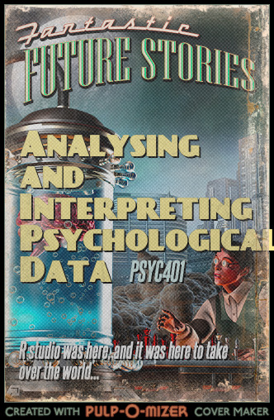
PSYC401: Analysing and Interpreting Psychological Data I
Padraic Monaghan
Room C5, Fylde College
p.monaghan@lancaster.ac.uk

Slide 2
Module outline
Week 1: Introducing data, introducing Rstudio
Week 2: Manipulating data, using Rstudio
Week 3: Exploring data and creating figures and graphs, using Rstudio
Week 4: Categorical data and the chi-squared test – testing random versus structured?
Week 5: t-tests – testing whether two groups are different
Week 6: Open data and your research report
Week 7: Questions, measurements and people
Weeks 8: Estimating and testing associations: correlations
Weeks 9: Predicting behaviour: the linear model
Weeks 10: Predicting behaviour: the linear model part 2

Slide 3
Objectives for Week 3
By the end of this session, you should be able to:
Understand the requirements for the short report assessment in PSYC401
See how data gathering for vocabulary knowledge can be conducted
Understand different types of reproducibility
Understand the relations between observed score, true score, and error score
Understand multiple types of graphs and how to construct them in Rstudio
Manipulate data, including filtering, grouping and summarizing data in Rstudio

Slide 4
Reproducibility - types
Gilmore et al. (2017) discuss three kinds of reproducibility:
Methods reproducibility – when a different researcher can get the same results when applying the same tools and analytical procedures to the same data-set to address the same research question
Results reproducibility – when a new study with new data, collected following the same procedure as the original study, yields the same results
Inferential reproducibility – when independent researchers make similar conclusions about what data mean, based on their own new replication study, or a reanalysis of old data from a previous study
Gilmore, R. O., Diaz, M. T., Wyble, B. A., & Yarkoni, T. (2017). Progress toward openness, transparency, and reproducibility in cognitive neuroscience. Annals of the New York Academy of Sciences, 1396(1), 5-18.

Slide 5
Reproducibility – reporting methods
If you try to replicate or reproduce the results from a published study, you will learn to read the results sections in research articles more effectively
You will need to identify the key statistical test, but finding it is not always easy (Hawkins et al., 2018)
You will read the “recipe” for the data analysis the researchers did, but find that research articles do not always present clear explanations of how an analysis was done, or why (Frank & Saxe, 2012)
What you learn as readers will teach you how to explain your analysis approach, and your results, more effectively
Hawkins, R. X., Smith, E. N., Au, C., et al. (2018). Improving the replicability of psychological science through pedagogy. Advances in Methods and Practices in Psychological Science, 1(1), 7-18.
Frank, M. C., & Saxe, R. (2012). Teaching replication. Perspectives on Psychological Science, 7(6), 600-604.

Slide 6

Reproducibility – variation and reliability – an illustration
You want to find out how quickly an individual responds to a visual stimulus
Are there individual differences in this?
Task for your participants:
When you see a red light press this button as fast as you can.
Ready?

Slide 7
Reproducibility – variation and reliability – what factors affect a particular measurement?
What factors might affect a response time?
What will happen if you measure a response time over and over and over and over again?

Slide 8
Reproducibility – variation and reliability – sample of 5 data points

Slide 9
Reproducibility – variation and reliability – sample of 25

Slide 10
Reproducibility – variation and reliability – sample of 100

Slide 11
Reproducibility – variation and reliability – sample of 1000

Slide 12
Reproducibility – variation and reliability – sample of 100,000

Slide 13
Reproducibility – variation and reliability – true score
Results will not replicate perfectly, because responses contain noise
observed scores are a combination of true score and error
If the error is random then
some people will accidentally score more, and some less, than their true score
true differences between participants’ scores will be unrelated to error differences
So the total variance of observed scores, for a sample of participants, will equal the variance of their true scores plus the variance of their error scores sd_{obs}² = sd_{true}² + sd_{err}²
Reliability is an estimate of how much variance is true score and how much is error

Slide 14
Reproducibility – variation and reliability – test-retest reliability
One type of reliability estimation is test-retest reliability
Do people score similarly if they take the same test again?
This is why we took the Gent vocabulary test twice – is it reliable?

Slide 15
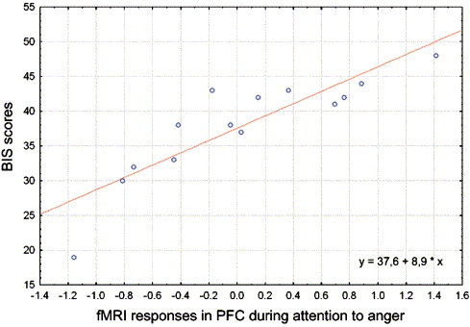
Reproducibility – why is reliability important?
We know that psychometric measures (e.g., personality variables) have reliability around 0.7-0.8
This means that if we take two tests then the scores are likely to be related (or similar) at around 0.7
Sander et al. (2005) related activity of the PFC to scores on a questionnaire about inhibition
They found scores were similar at 0.96
Sander, D., Grandjean, D., Pourtois, G., Schwartz, S., Seghier, M. L., Scherer, K. R., & Vuilleumier, P. (2005). Emotion and attention interactions in social cognition: brain regions involved in processing anger prosody. Neuroimage, 28(4), 848-858.

Slide 16
Reproducibility – voodoo correlations
Vul et al. (2009) pointed out 0.96 similarity was surprising…
The questionnaire only overlaps with itself with max score 0.74 (its reliability 0.74)
Can a measure overlap with a test more than the test itself
Not likely, to say the least…
Vul, E., Harris, C., Winkielman, P., & Pashler, H. (2009) Puzzlingly high correlations in fMRI studies of emotion, personality, and social cognition. Perspectives on Psychological Science, 4, 274–290.
Notes:
(the paper formerly known as Voodoo Correlations in Social Neuroscience).

Slide 17
Summary
Different types of reproducibility
Relations between observed score, true score, and error score
The benefit of manipulating, grouping, summarising data
The benefit of exploring data in various graphs
The importance of highlighting dispersion, or variance, in data

